Slide 1
Panel: Hear from the IoIC Awards Judges

Slide 2
Welcome
Justine Stevenson, IoIC Awards Chairman, IoIC Board Member and
Director of Internal Communication and Employee Engagement at AQA
We are delighted to welcome:
Will Fox, Internal Communications Manager, Bakkavor
Sandra Lowman-Simpson, Communications Practitioner
Sonia Squires, Head of Internal Communications, Citizen Housing
Claire Widd, Head of Marketing and Communications, UKAS

Slide 3
Celebrating 70 Years of Internal Communication Excellence
Our 38 classes give you the opportunity to show off your work in strategy, planning and delivery, across:
Strategy and Campaigns
Skills
Channels
Innovation
People
Team
2025 Changes
The word "National" has been dropped from the title, this is to represent that the IoIC Awards are open to everyone from around the World.
Three new classes: Best Strategy Development (Strategy); Best Community Management (Channels); Most Innovative Content Creation (Innovation)
The Skills category has changed to be clearer and better reflect what internal communication professionals do every day

Slide 4
Entry process
Purchase your entry/entries - To ensure you secure your entry, you will need to purchase your award entries before you can submit then you'll receive a link to enter
Ensure your Entry Statement and Executive Summary are ready - Go to www.ioic.org.uk/awards/how-to-enter for guidance on these including word count
Supporting materials - Include a selection that strengthen your entry by providing evidence of your achievements (you can see examples on the website)
Complete the application form - You can start each entry and save it as a draft to submit at a later time (by the required deadline - 29 February for Early Bird and 25 April for Standard entry)
There’s a discount for 3 or more entries and a 10% discount for not for profit/public sector entries
All entrants receive a judges' critique which will highlight what the judges really appreciated and some suggestions of what you might improve or develop in the future
Please read all the tips for how to enter (www.ioic.org.uk/awards/entry-guidance) and if you need further advice please email awards@ioic.org.uk

Slide 5
Thank you
Any questions?

Slide 6
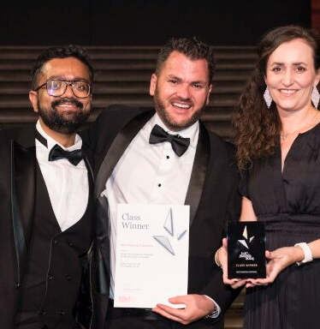
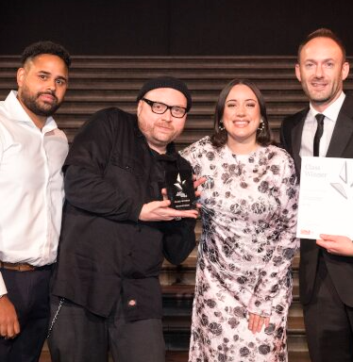
Dates to remember
Early Bird Deadline – Friday 28 Feburary
Standard Deadline – Friday 25 April

