Slide 1
Benefits of
IoIC Membership
Designed to support you at every
stage of your career

Slide 2
Benefits of IoIC Membership
Ability to demonstrate your professional credibility to the highest standards
Receive our quarterly physical magazine: Voice
Discounted access to the IoIC Festival
Access to a wealth of online content including factsheets, case studies and articles
Free access to virtual and regional events
Recognised learning and development
Access to our improved online CPD portal
Registration for our mentoring programme
Discounted Award entries
Opportunity to network with like-minded peers

Slide 3
IoIC Membership gives you access to:
Professional Standards & Recognition
Recognised Learning & Development
Content & Knowledge
Events & Networks

Slide 4
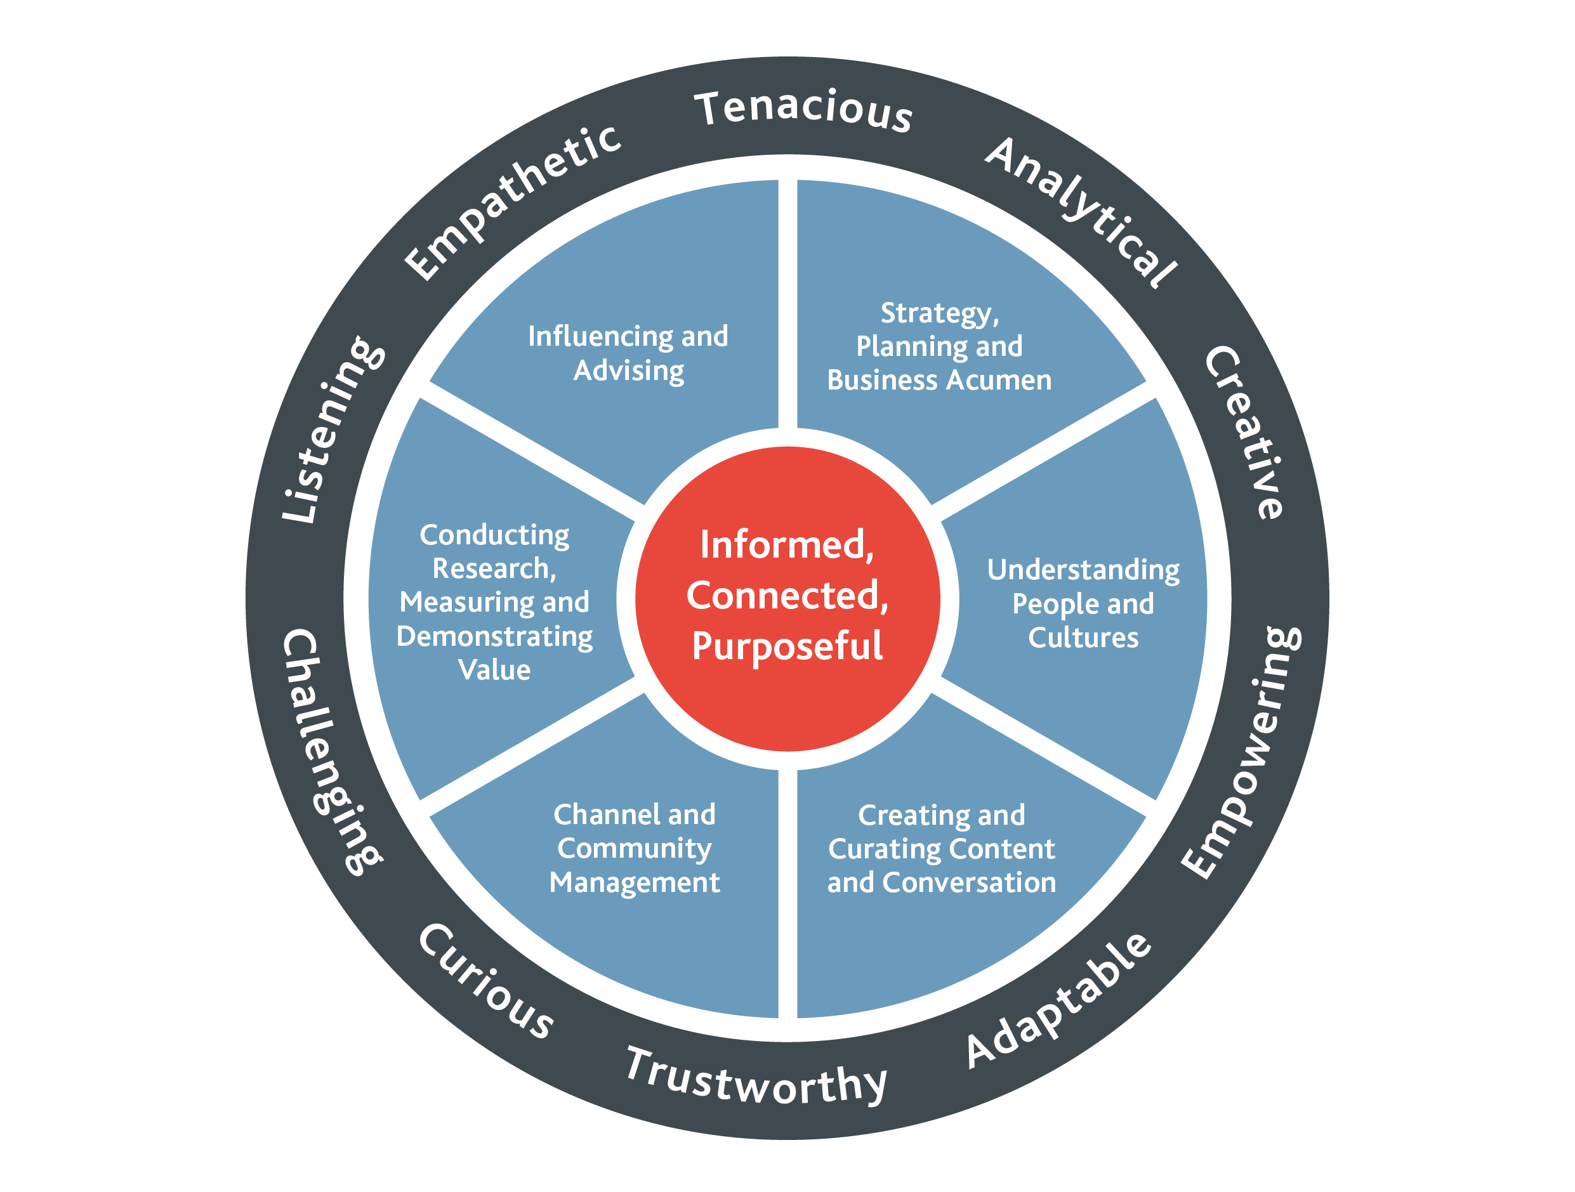
The Profession Map

Slide 5
The Levels
Level 1: Delivering | Delivering high-quality communication materials with a focus on content creation, potentially designing, and the day-to-day administration of communication channels/ infrastructure.
Level 2: Managing | Responsible for channel management, delivery, and evaluation; practical communication planning and providing advice to project teams and other stakeholders.
Level 3: Strategically Advising | Working with business areas to advise on communication strategies and approaches; development of overall channel infrastructure and evaluation processes; and supporting leaders in becoming highly effective communicators.
Level 4: Leading | Working at a senior level to lead thinking on internal communication; ensuring communication strategies meet business needs and that effective communication is built into the fabric of the organisation.

Slide 6
Content, Knowledge and Opportunities
Voice magazine: Our quarterly physical magazine
Knowledge Hub: Our improved hub with more than 800 resources
Thought Leadership: Reports examining Future of Work, IC Index, AI
Ethical Guidance for IoIC members
Improved CPD to make it easier for members and more new courses
Recognition at the IoIC National Awards
Actively seeking speakers: Your chance to showcase success and present new insights
Coming in 2024: Online community platform

Slide 7
Want to discuss your membership or find out more?
Please see the IoIC team tonight

